Slide 1
Congestion Control and
Quality of Service
Lecture 39
Computer Networks-CS156

Slide 2
Index
Congestion Control and
Quality of Service
Computer Networks

Slide 3
DATA TRAFFIC
The main focus of congestion control and quality of service is data traffic. In congestion control we try to avoid traffic congestion. In quality of service, we try to create an appropriate environment for the traffic. So, before talking about congestion control and quality of service, we discuss the data traffic itself.
Notes:
3

Slide 4
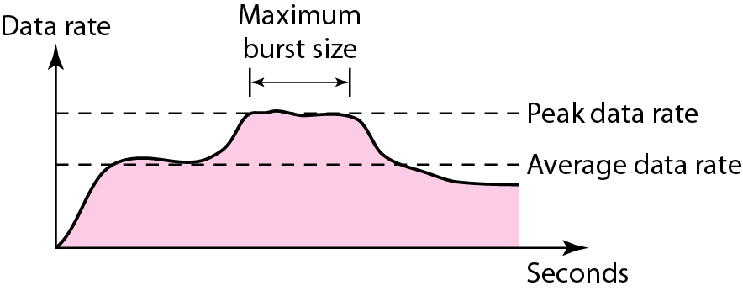
Traffic descriptors
Figure 1 Traffic descriptors
Notes:
4

Slide 5
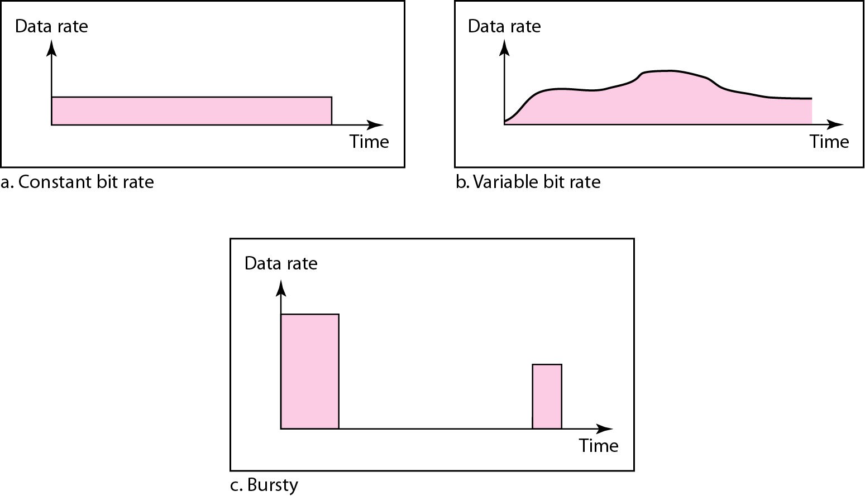
Three traffic profiles
Figure 2 Three traffic profiles
Notes:
5

Slide 6
2 CONGESTION
Congestion in a network may occur if the load on the network—the number of packets sent to the network—is greater than the capacity of the network—the number of packets a network can handle. Congestion control refers to the mechanisms and techniques to control the congestion and keep the load below the capacity.
Notes:
6

Slide 7
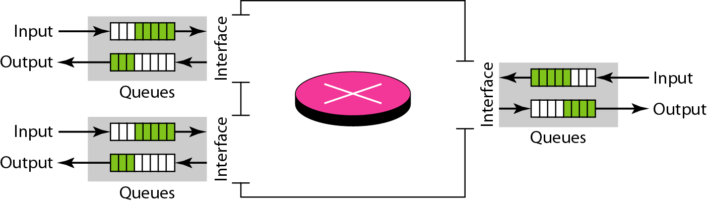
Queues in a router
Figure 3 Queues in a router
Notes:
7

Slide 8
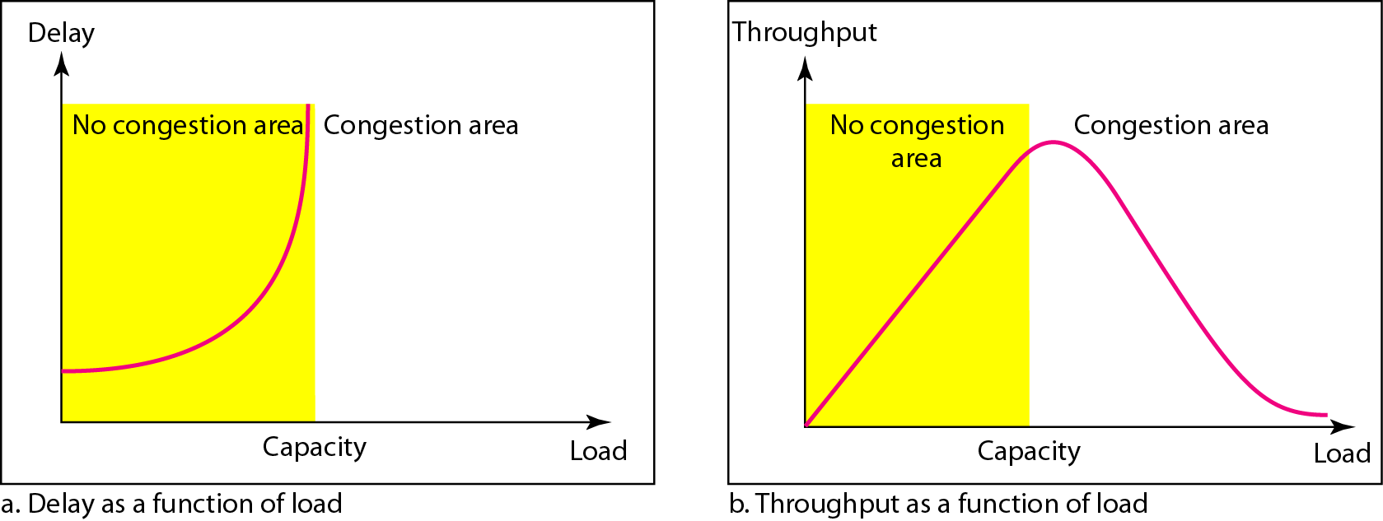
Packet delay and throughput as functions of load
Figure 4 Packet delay and throughput as functions of load
Notes:
8

Slide 9
3 CONGESTION CONTROL
Congestion control refers to techniques and mechanisms that can either prevent congestion, before it happens, or remove congestion, after it has happened. In general, we can divide congestion control mechanisms into two broad categories: open-loop congestion control (prevention) and closed-loop congestion control (removal).
Notes:
9

Slide 10
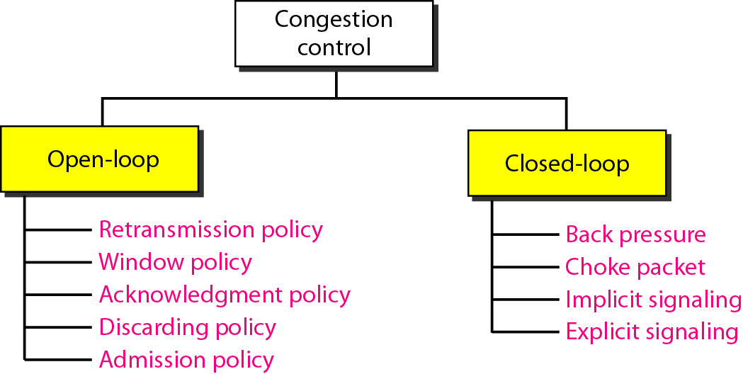
Congestion control categories
Figure 5 Congestion control categories
Notes:
10

Slide 11
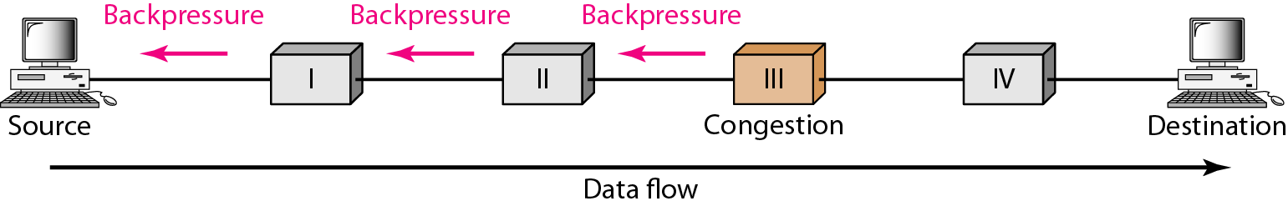
Backpressure method for alleviating congestion
Figure 6 Backpressure method for alleviating congestion
Notes:
11

Slide 12
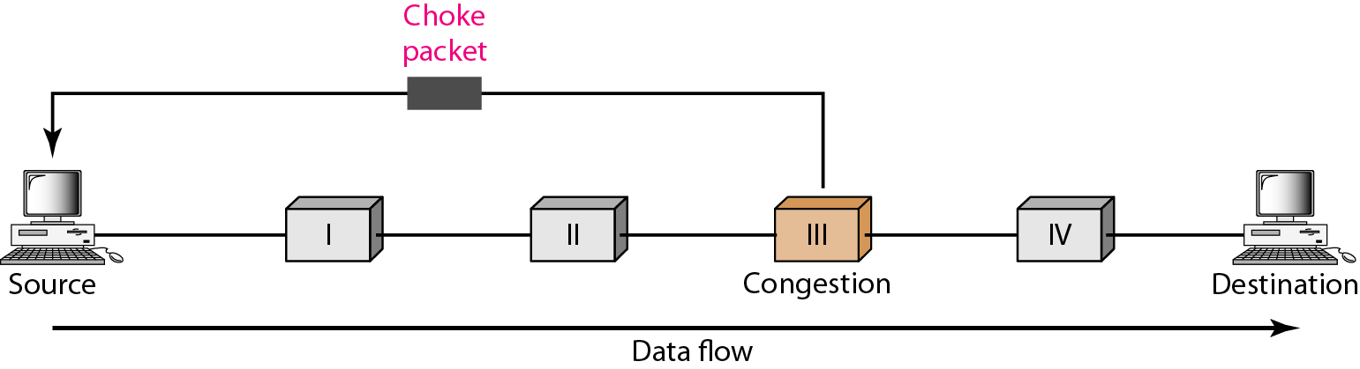
Choke packet
Figure 7 Choke packet
Notes:
12

Slide 13
4 TWO EXAMPLES
To better understand the concept of congestion control, let us give two examples: one in TCP and the other in Frame Relay.
Notes:
13

Slide 14
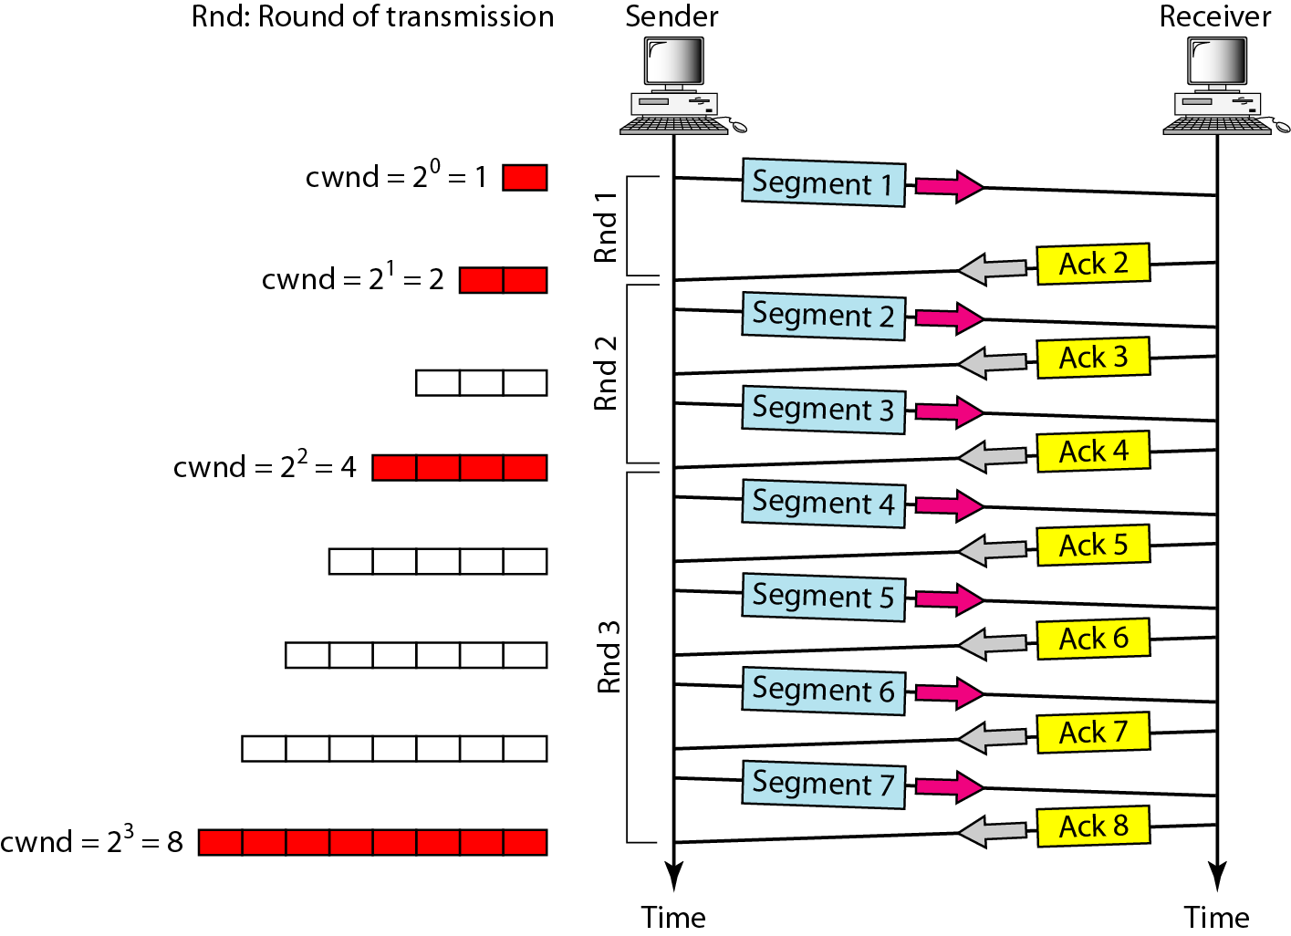
Slow start, exponential increase
Figure 8 Slow start, exponential increase
Notes:
14

Slide 15

Note
In the slow-start algorithm, the size of the congestion window increases exponentially until it reaches a threshold.
Notes:
15

Slide 16
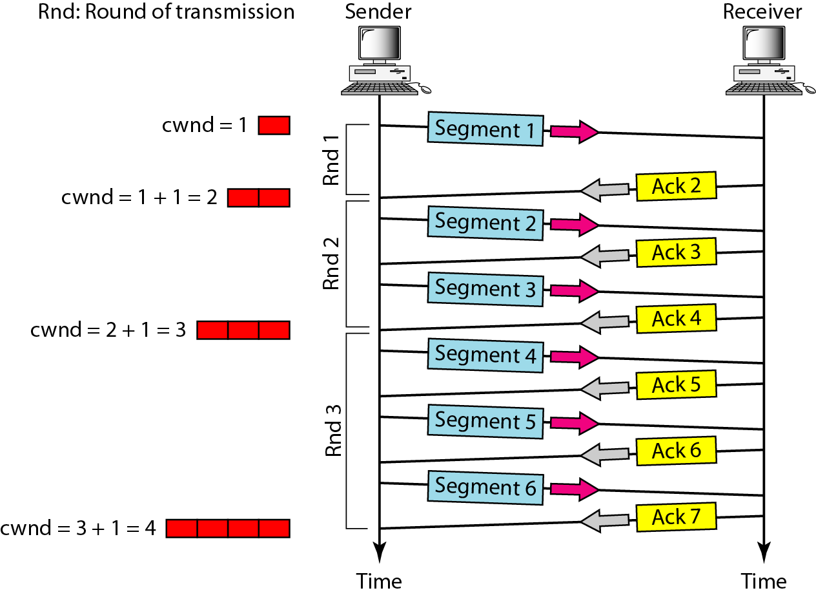
Congestion avoidance, additive increase
Figure 9 Congestion avoidance, additive increase
Notes:
16

Slide 17
Note
In the congestion avoidance algorithm, the size of the congestion window increases additively until congestion is detected.
Notes:
17

Slide 18
Note
An implementation reacts to congestion detection in one of the following ways:
❏ If detection is by time-out, a new slow start phase starts.
❏ If detection is by three ACKs, a new congestion avoidance phase starts.
Notes:
18

Slide 19
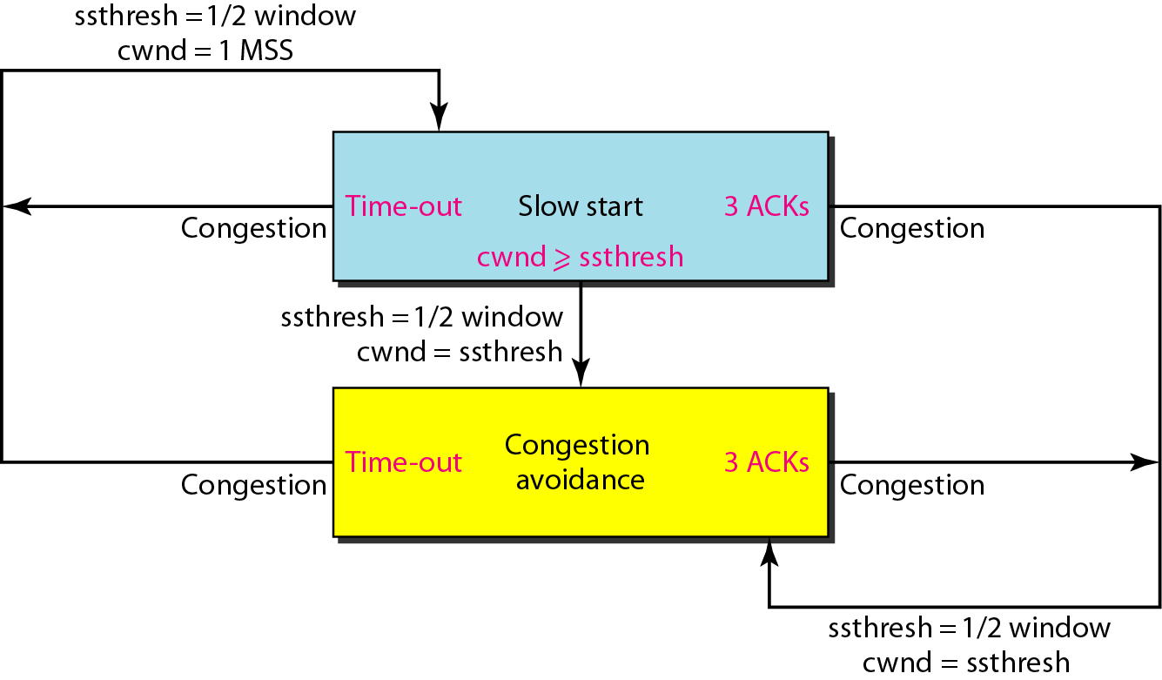
TCP congestion policy summary
Figure 10 TCP congestion policy summary
Notes:
19

Slide 20
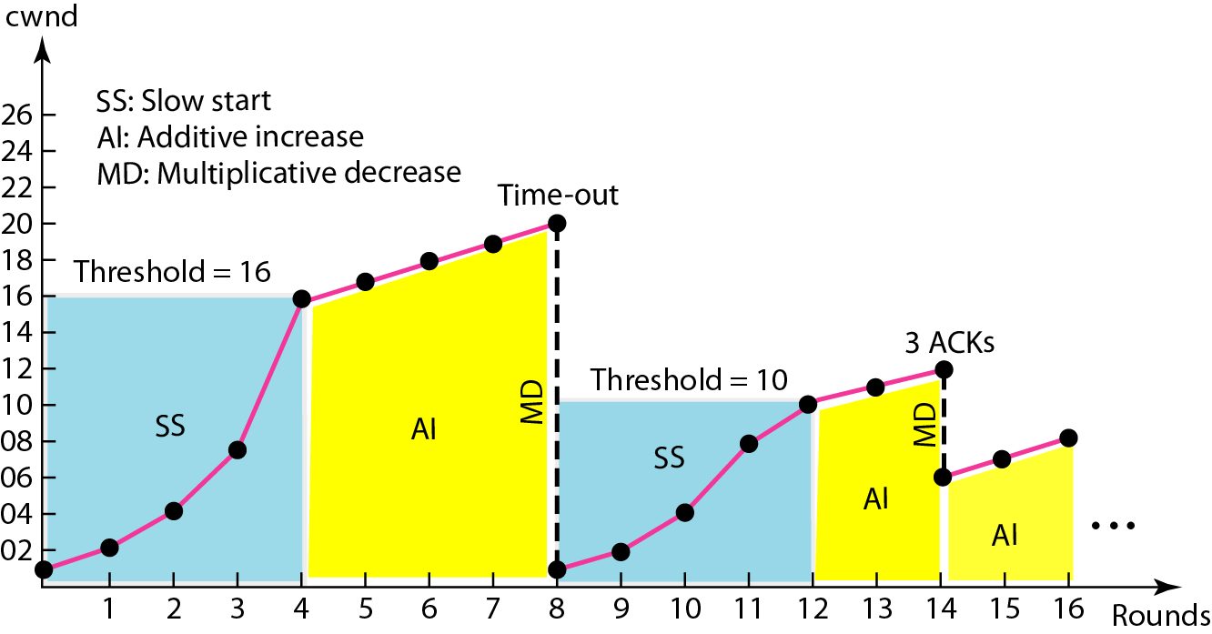
Congestion example
Figure 11 Congestion example
Notes:
20

Slide 21
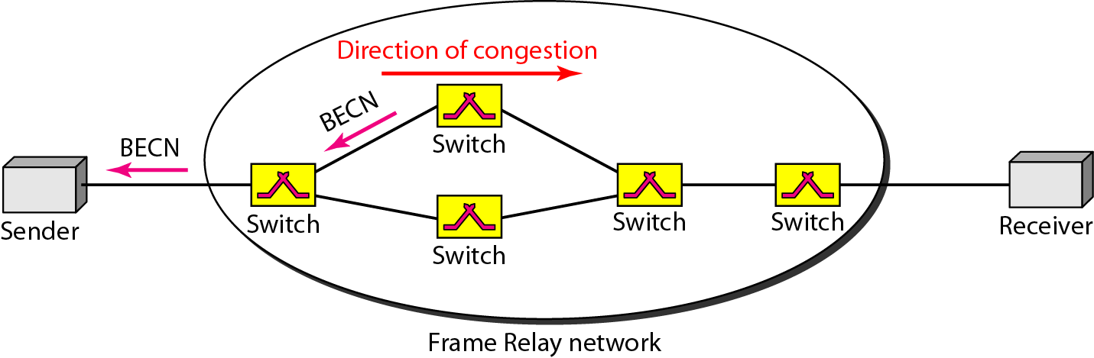
BECN
Figure 12 BECN
Notes:
21

Slide 22
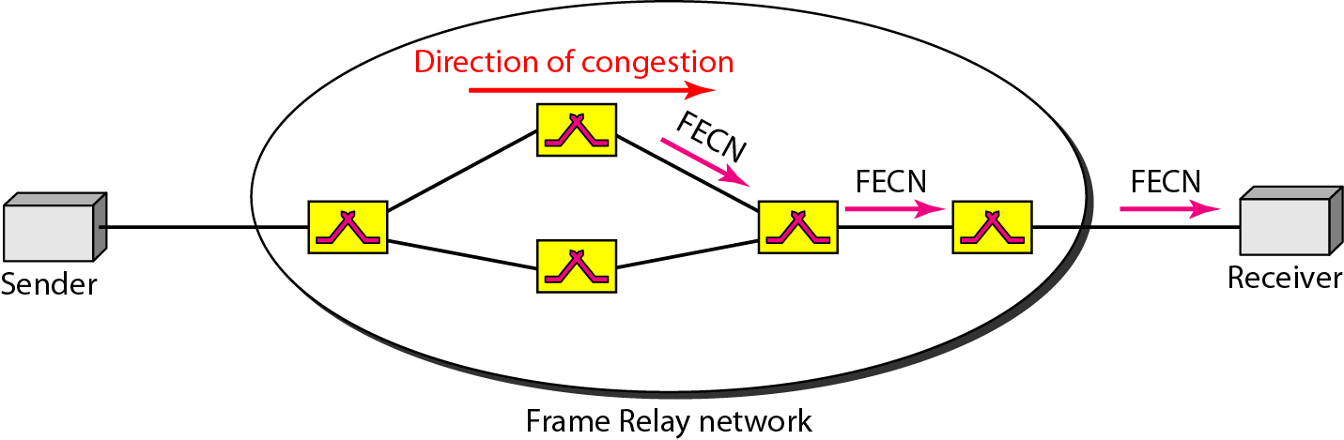
FECN
Figure 13 FECN
Notes:
22

Slide 23
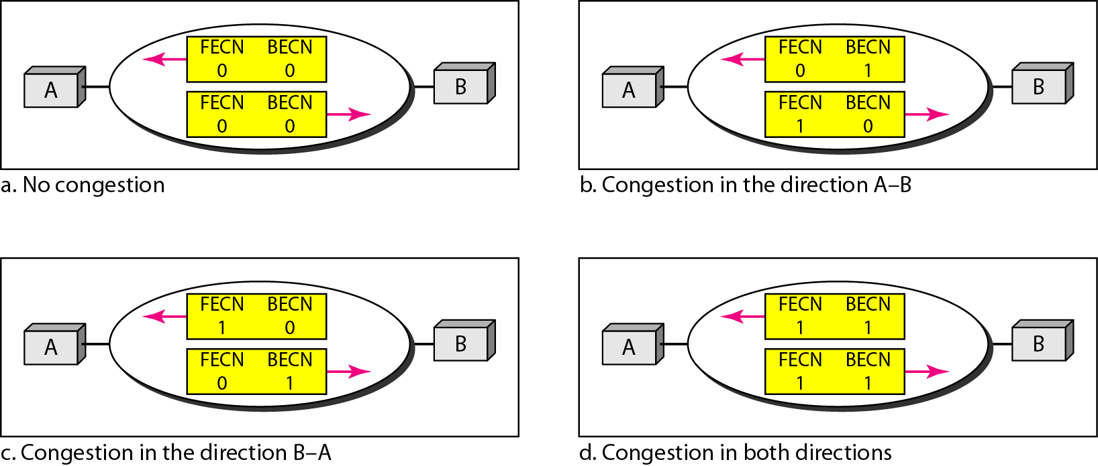
Four cases of congestion
Figure 14 Four cases of congestion
Notes:
23

Slide 24
5 QUALITY OF SERVICE
Quality of service (QoS) is an internetworking issue that has been discussed more than defined. We can informally define quality of service as something a flow seeks to attain.
Notes:
24

Slide 25
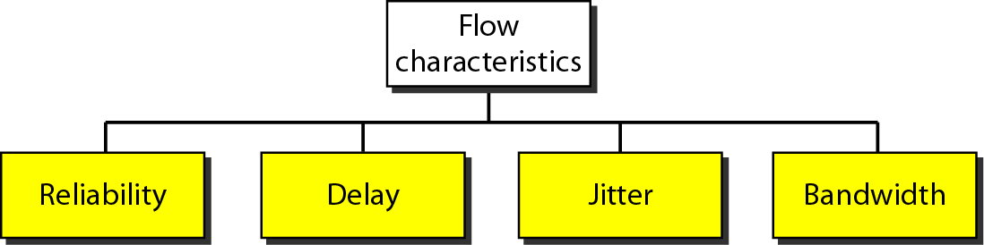
Flow characteristics
Figure 15 Flow characteristics
Notes:
25

Slide 26
6 TECHNIQUES TO IMPROVE QoS
In Section 5 we tried to define QoS in terms of its characteristics. In this section, we discuss some techniques that can be used to improve the quality of service. We briefly discuss four common methods: scheduling, traffic shaping, admission control, and resource reservation.
Notes:
26

Slide 27
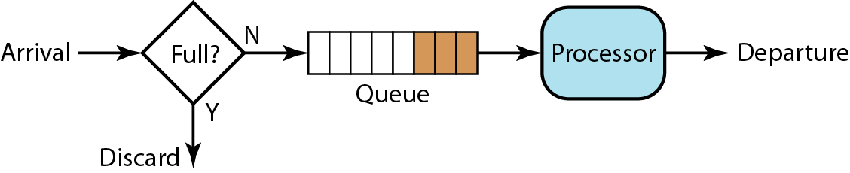
FIFO queue
Figure 16 FIFO queue
Notes:
27

Slide 28
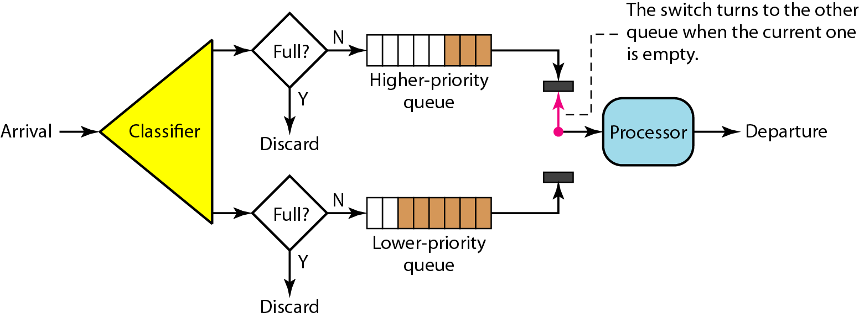
Priority queuing
Figure 17 Priority queuing
Notes:
28

Slide 29
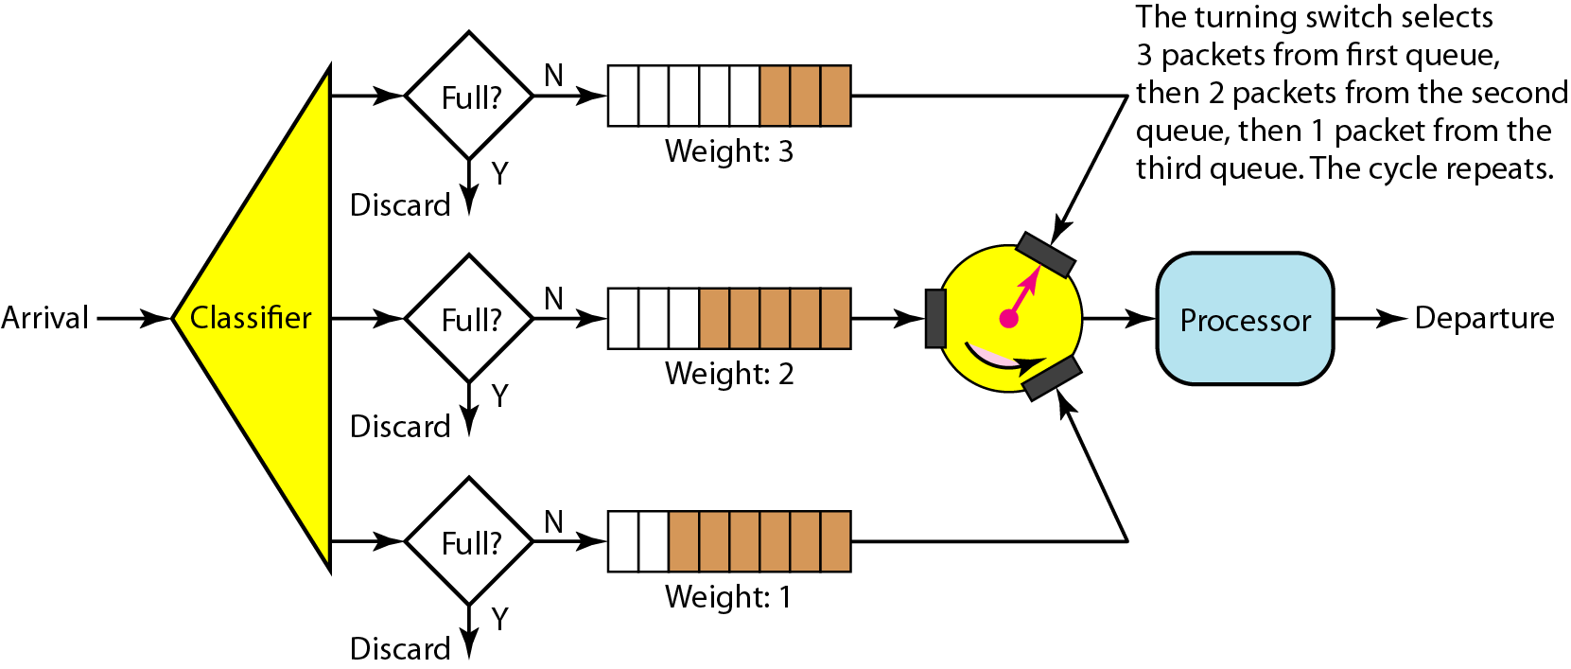
Weighted fair queuing
Figure 18 Weighted fair queuing
Notes:
29

Slide 30
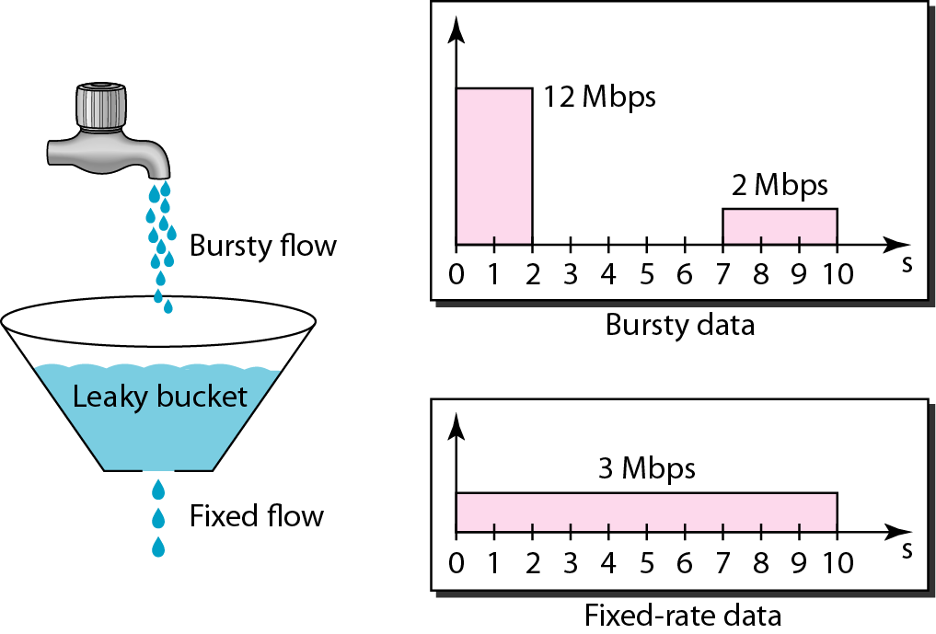
Leaky bucket
Figure 19 Leaky bucket
Notes:
30

Slide 31
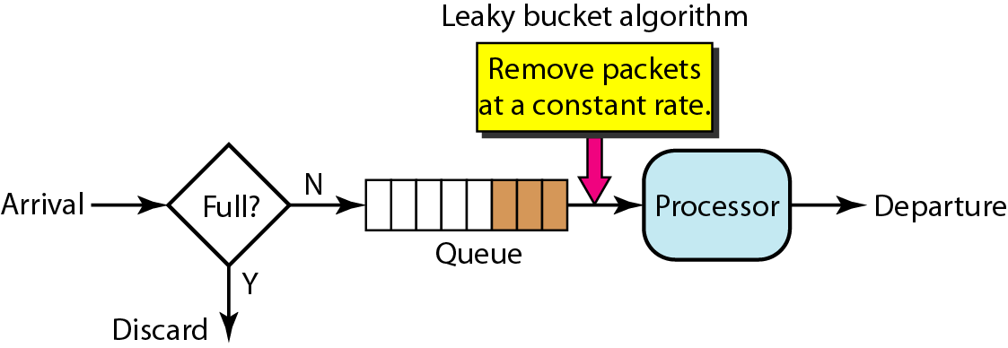
Leaky bucket implementation
Figure 20 Leaky bucket implementation
Notes:
31

Slide 32
Note
A leaky bucket algorithm shapes bursty traffic into fixed-rate traffic by averaging the data rate. It may drop the packets if the bucket is full.
Notes:
32

Slide 33
Note
The token bucket allows bursty traffic at a regulated maximum rate.
Notes:
33

Slide 34
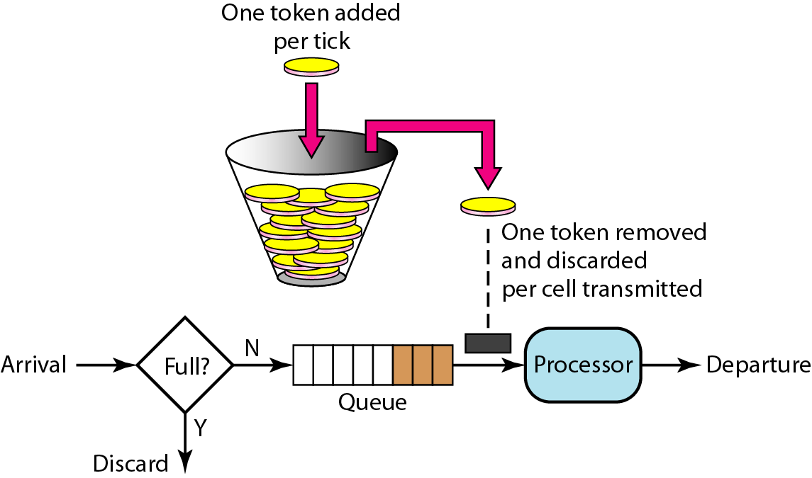
Token bucket
Figure 21 Token bucket
Notes:
34

Slide 35
7 INTEGRATED SERVICES
Two models have been designed to provide quality of service in the Internet: Integrated Services and Differentiated Services. We discuss the first model here.
Notes:
35

Slide 36
Note
Integrated Services is a flow-based QoS model designed for IP.
Notes:
36

Slide 37
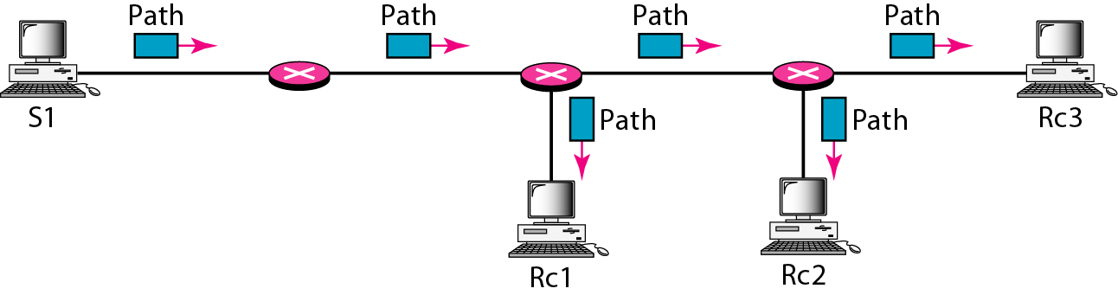
Path messages
Figure 22 Path messages
Notes:
37

Slide 38
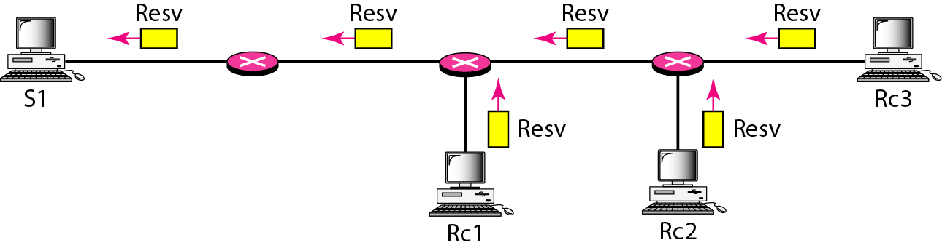
Resv messages
Figure 23 Resv messages
Notes:
38

Slide 39
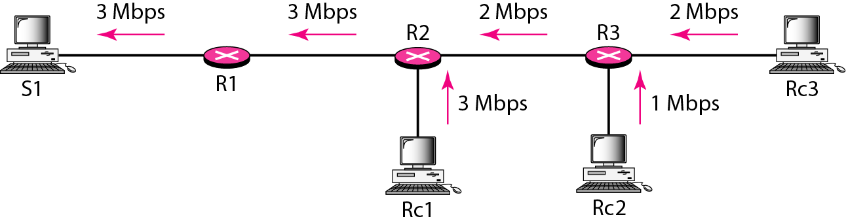
Reservation merging
Figure 24 Reservation merging
Notes:
39

Slide 40
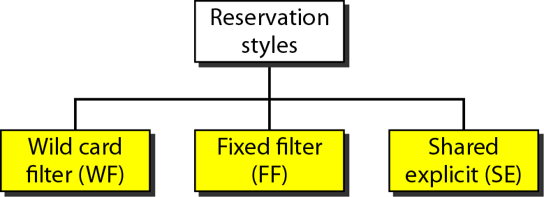
Reservation styles
Figure 25 Reservation styles
Notes:
40

Slide 41
8 DIFFERENTIATED SERVICES
Differentiated Services (DS or Diffserv) was introduced by the IETF (Internet Engineering Task Force) to handle the shortcomings of Integrated Services.
Notes:
41

Slide 42
Note
Differentiated Services is a class-based QoS model designed for IP.
Notes:
42

Slide 43

DS field
Figure 26 DS field
Notes:
43

Slide 44
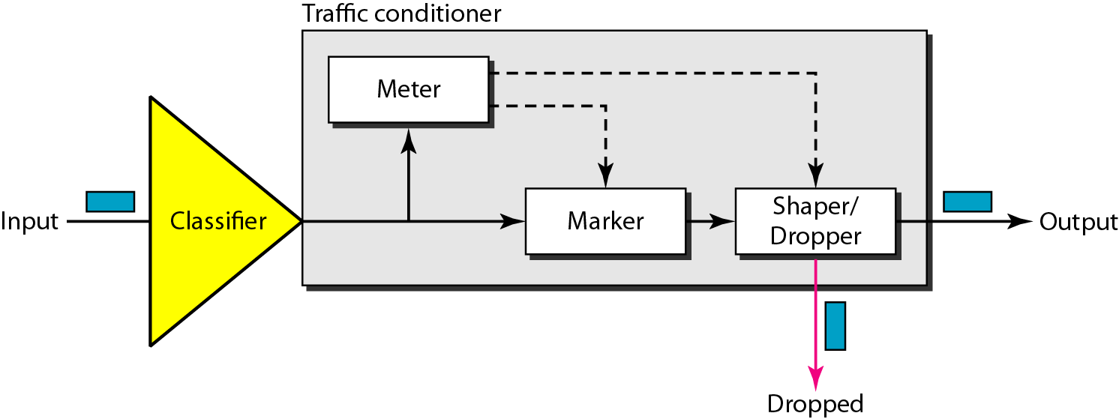
Traffic conditioner
Figure 27 Traffic conditioner
Notes:
44

Slide 45
9 QoS IN SWITCHED NETWORKS
Let us now discuss QoS as used in two switched networks: Frame Relay and ATM. These two networks are virtual-circuit networks that need a signaling protocol such as RSVP.
Notes:
45

Slide 46
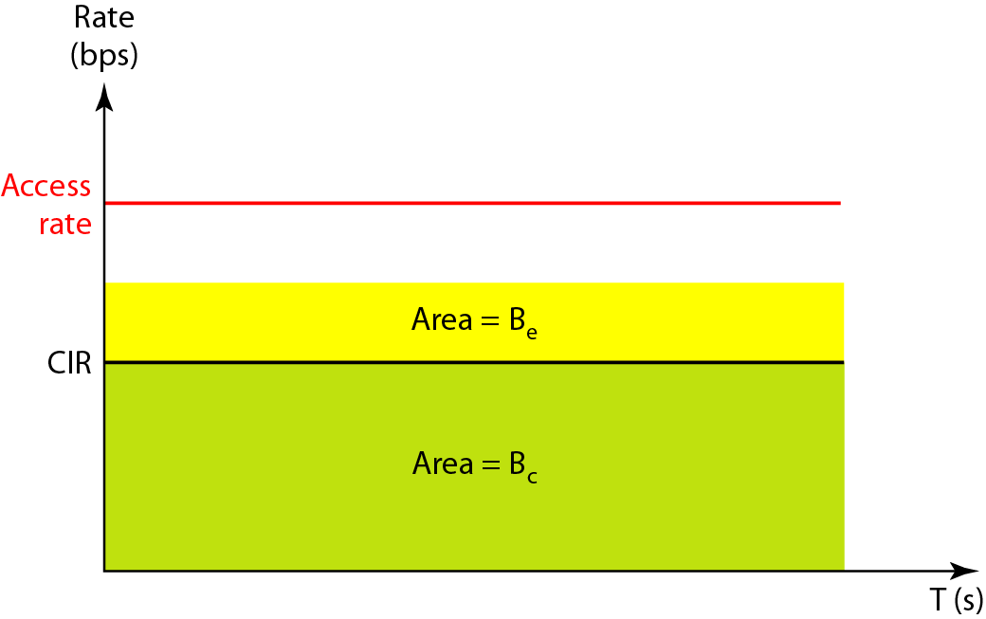
Relationship between traffic control attributes
Figure 28 Relationship between traffic control attributes
Notes:
46

Slide 47
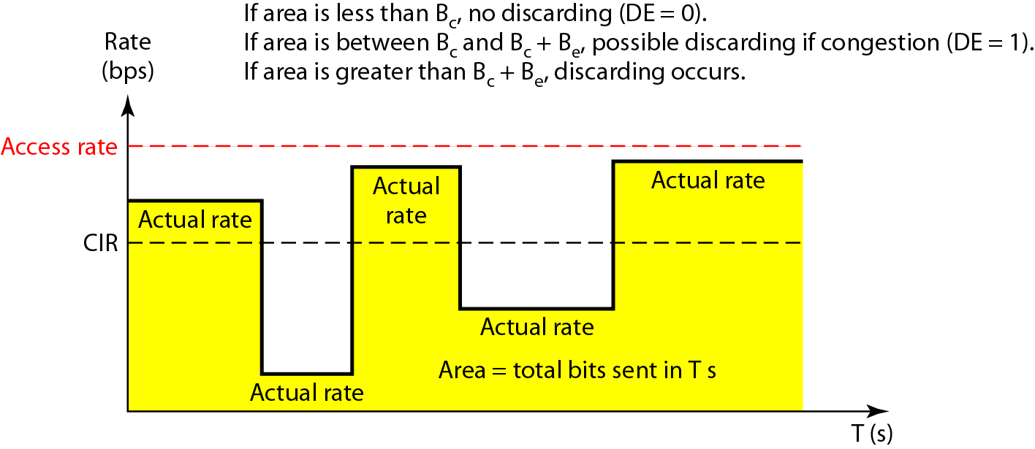
User rate in relation to Bc and Bc + Be
Figure 29 User rate in relation to Bc and Bc + Be
Notes:
47

Slide 48
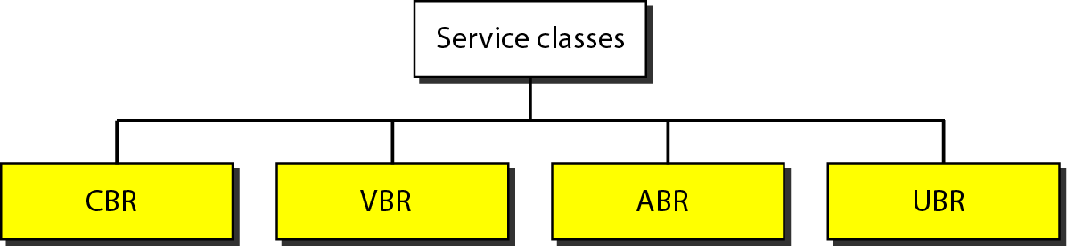
Service classes
Figure 30 Service classes
24.48
Notes:
48

Slide 49
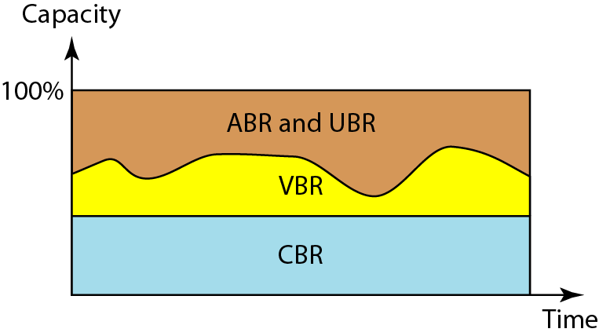
Relationship of service classes to the total capacity of
the network
Figure 31 Relationship of service classes to the total capacity of the network
Notes:
49

Slide 50
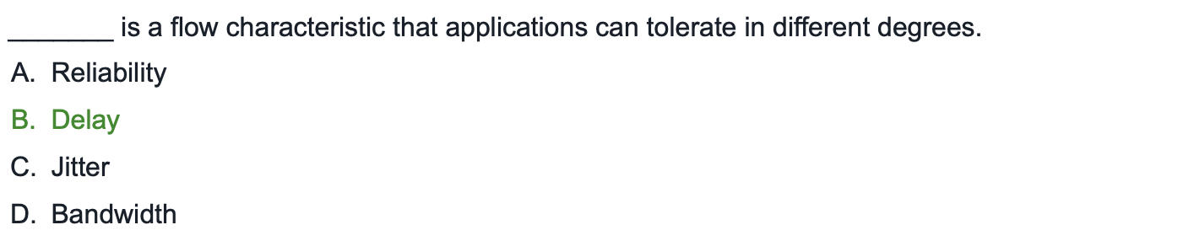
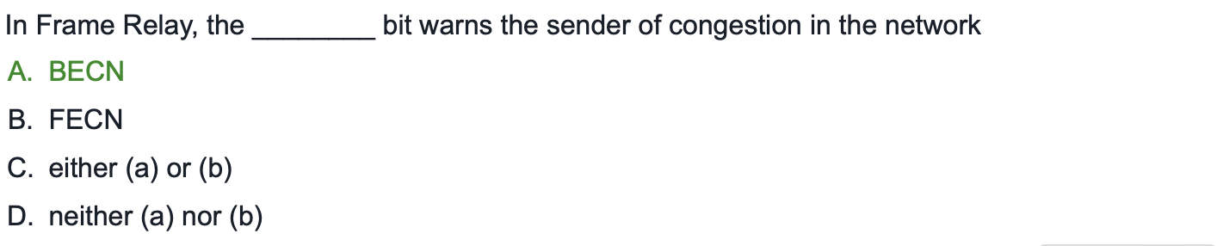
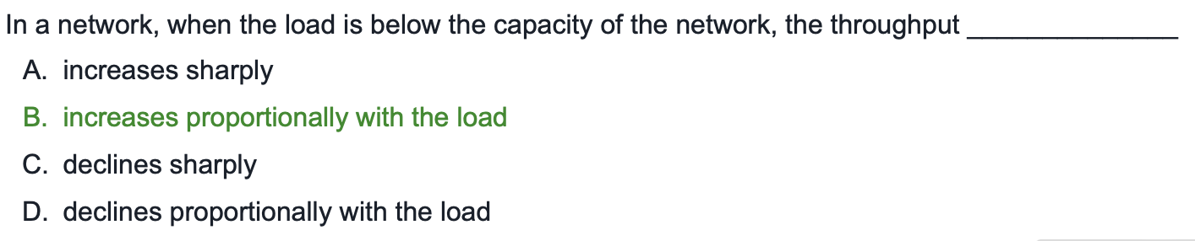
Practice Questions
24.50

Slide 51
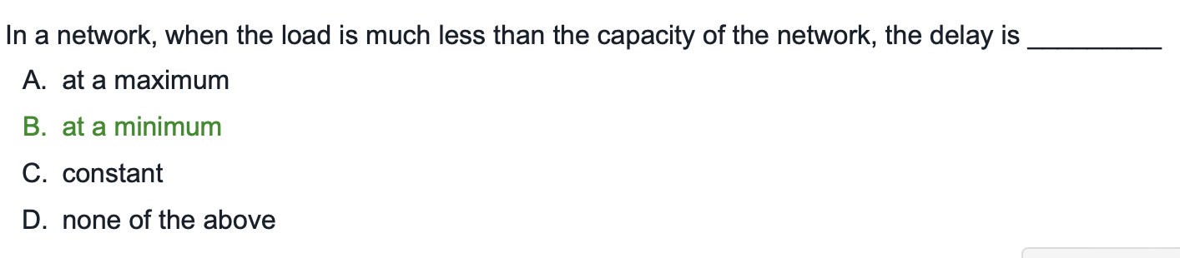
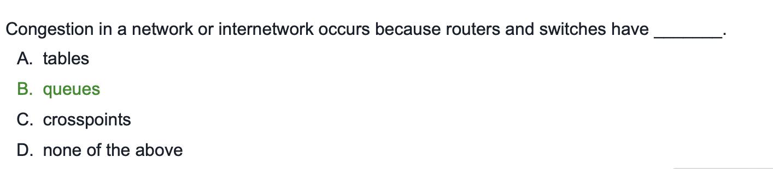

Slide 52
Computer Networks

